Slide 1

Lab 4 — Building Microservices for your Smart Space
B8019 · Programming the Internet of Things · Spring 2026
Professor Sumi Helal
Due 12:00 noon, 27 April 2026
Notes:
Lab 4 moves us from wiring and dashboards to thinking in services: describing what each IoT thing can do, advertising it, and composing those services into applications. It is the stepping stone to the final project.

Slide 2



Where Lab 4 sits in your smart space
Your path so far
Private cloud
Hosts IoT applications such as your Metronome dashboard
Lab 1
Built the VSS: private cloud, Edge laptop(s) and RPi things on a private network
Edge (one or two laptops)
Labs 2–3
Physical + Edge layers: metronome circuit on the RPi and an HTML dashboard over REST & MQTT
Relays commands down and data up via RESTful APIs
IoT things (RPi platforms)
Lab 4
Think in services: describe, advertise and compose them — a step toward the final project
Sensors and actuators run instructions and return results
Notes:
Recap the three VSS layers. Labs 2 and 3 covered the physical and Edge layers with the metronome. Lab 4 shifts the focus to the services those things offer and how applications are composed from them.

Slide 3


Services shape what you can build
Temperature sensor
Smart lamp
Simple IoT thing · few services
Complex IoT thing · many services
Report current temperature in °F
Report current temperature in °C
On/off switching
Brightness and warmth control
Light dimming
Timed operations
More services → more possible applications. But meaningful applications come from the relationships between services — the virtual links you will program in this lab.
Notes:
Users and developers compose IoT applications from the services things expose. Richer things widen the application space, but only once we know how services relate to one another.

Slide 4
Two relationships link services
1 · Order-based
2 · Condition-based
Service B may run only after Service A runs successfully to completion.
Service B runs conditionally, based on a specific outcome (return value) of Service A.
Service A
completes ✓
Service B
Service A
result = x?
Service B
yes
Example: Calibrate, then Read_Temp
Example: if Read_Temp(C) > 28, run Fan_On
Notes:
Only these two relationships are in scope for Lab 4. Order-based: sequencing on successful completion. Condition-based: branching on a return value. The example service names are illustrative.

Slide 5
Connecting multiple services to build an IoT application
PART ONE
Prepare the physical and Edge layers, build a tiny IDE, and run your first composed application. RPi code is C/C++ only — no Python in this assignment.
Notes:
Part One extends Labs 1 and 2 and is a stepping stone toward the final project.

Slide 6
Six steps from idea to running app
1
Scenario
2
Physical layer
3
Edge layer
Pick an interesting, feasible app using class sensors and actuators — or ones your group acquires.
RPi-1 hosts the sensors, RPi-2 the actuators (or use RPi-1). Wire, code in C/C++, and test.
Both RPis connect and report their services; the Edge shows them on a web dashboard.
4
Mini-IDE
5
Build & run
6
Results
Let users compose apps with the two relationships — text commands or point, click, drag.
Compose an app in your IDE; the Edge translates it into service API calls.
The Edge controls the call order, collects results from the things, and displays them.
Notes:
Walk through the six steps. Stress testing at Step 2 — confirm sensor readings and actuation before moving up the stack. Step 4 is highlighted because the IDE is the new idea here: a very small, very limited programming environment.

Slide 7

Step 3: advertise every service as a vector
(
RPi2
Read_Temp
1
F_or_C
)
RPi identifier
Service name
No. of inputs
Input parameter names
RPi-1 & RPi-2
Edge device
Web dashboard
Connect to the Edge and report each service they offer
Collects the service vectors from every RPi
Lists the available services for the user
Notes:
The example from the handout: (RPi2, Read_Temp, 1, F_or_C). The Edge must collect these vectors from both Pis and present them on the dashboard so the user knows what is available to compose.

Slide 8




Steps 4–6: compose, translate, run
Example IDE program
Step 4 · Compose
User writes the app in the IDE using order and condition relationships
// order-based: B after A succeeds
RUN RPi2.Calibrate()
THEN RPi1.Read_Temp(C)
// condition-based: B on A's result
IF RPi1.Read_Temp(C) > 28
DO RPi2.Fan_On()
Step 5 · Translate
The Edge turns the app into a set of service API calls to the RPi things
Step 6 · Orchestrate
The Edge controls call order and checks returned values for conditions
Step 6 · Display
Illustrative syntax only — each group designs its own text-based or point-and-click IDE.
The Edge collects results from the things and shows them to the user
Notes:
The IDE can be as simple as a command line. What matters is that the Edge translates the composed app into service calls, enforces ordering, evaluates conditions on return values, and reports results.

Slide 9
Describe and build your IoT Thing with Atlas
PART TWO
Write an IoT-DDL description, deploy the Atlas Thing Middleware on your Pi, and call the microservices it generates.
Notes:
Part Two takes the services built in Part One and lets the Atlas middleware generate, advertise and expose them automatically.

Slide 10



Atlas turns descriptions into services
Atlas Thing Middleware is a firmware layer embedded in each IoT thing. It integrates the thing into the VSS automatically, enabling thing-to-thing and thing-to-user/cloud communication.
IoT-DDL is an XML-based declarative language describing a thing's inner components, identity, capabilities, resources and services.
Advertise & discover
Broadcasts JSON tweets that summarize the thing to the smart space
Generate microservices
Creates microservices dynamically from the service descriptions
Expose APIs
Users and other things invoke the services through their APIs
Resources
Compose applications
Middleware: github.com/NickLiJunjie/AtlasThingMiddleware_RPI
Builder: cise.ufl.edu/~helal/Atlas-IoT-DDL-Builder.html
Programmers discover and combine services into IoT apps
Notes:
Atlas is the implementation of the key components of the Atlas Architecture covered in lecture. The IoT-DDL is what device owners write; the middleware does the rest.

Slide 11
Step 1: describe your Thing in IoT-DDL
Thing = your Raspberry Pi
Descriptive Metadata: main attributes and parameters
Each service defines
Libraries
Add wiringPi.h for any GPIO or ADC use
Service Inputs
Names and types; none (void) by default
bit-thing
Sensor entity
e.g., Read_Value()
bit-thing
Actuator entity
e.g., Set_Angle(deg)
ADC Configuration
MCP3008 or ADS1115, channel, result variable
Service Output
Return name and type; void by default
Functionality example (ADC on CH0)
value = mcpRead0;
// return is added automatically
Functionality
Reuse your Part One C/C++ code
Notes:
Use the IoT-DDL Builder (v3.0). Each Pi is a thing; each sensor and each actuator becomes its own entity, or bit-thing. Point students to the example Servo_Motor.xml in the AtlasFramework repo. In the ADC example, mcpRead0 is the variable named in ADC Configuration and value is the declared output.

Slide 12
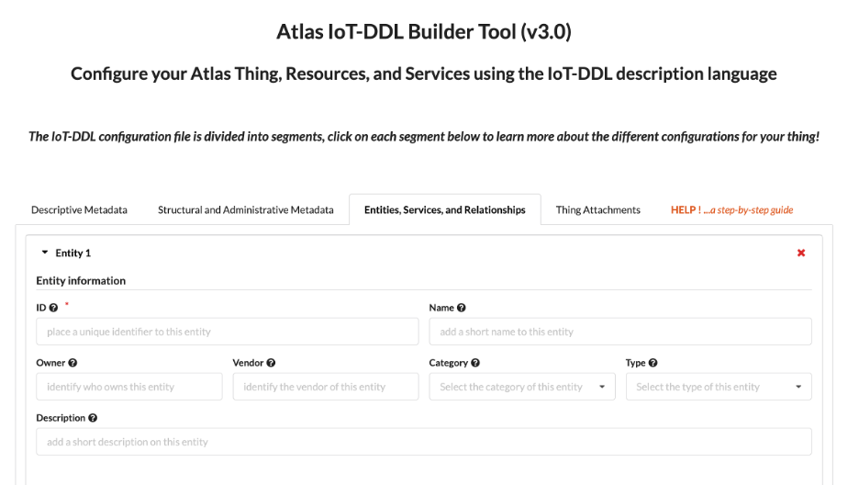
Step 1: describe your Thing in IoT-DDL
Notes:
Use the IoT-DDL Builder (v3.0). Each Pi is a thing; each sensor and each actuator becomes its own entity, or bit-thing. Point students to the example Servo_Motor.xml in the AtlasFramework repo. In the ADC example, mcpRead0 is the variable named in ADC Configuration and value is the declared output.

Slide 13
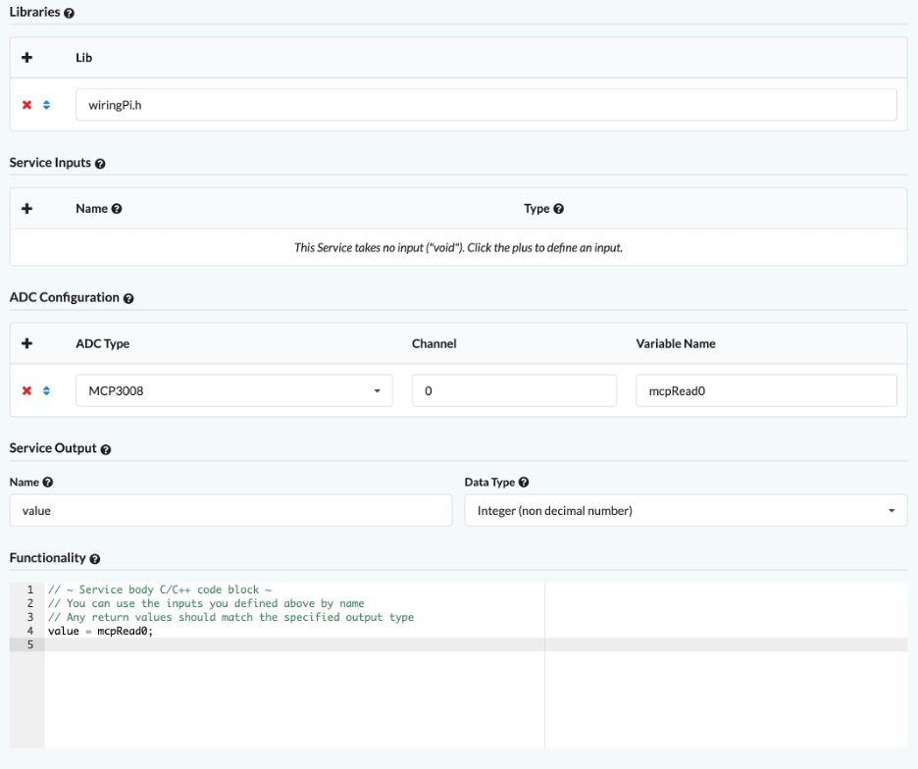
Step 1: describe your Thing in IoT-DDL
SERVICE INPUT - For each service you create, if your service involves GPIO, you need to add the required library header files in "Libraries" first. You can also specify the expected inputs for the service (no inputs by default) under “Service Inputs”. Under "ADC Configuration" (no ADC by default), you can select the ADC model and specify the Channel, and store the value read by the ADC in a variable with the variable name you specify, as shown in the figure below.
SERVICE OUTPUT - you can specify the expected output (the service returns void by default). Under “Functionality ", you should develop the C/C++ code for this service (you should import and "reuse" the code you developed in the first part).
Notes:
Use the IoT-DDL Builder (v3.0). Each Pi is a thing; each sensor and each actuator becomes its own entity, or bit-thing. Point students to the example Servo_Motor.xml in the AtlasFramework repo. In the ADC example, mcpRead0 is the variable named in ADC Configuration and value is the declared output.

Slide 14
Example IoT-DDL Descriptions
An example IoT-DDL for a Servo motor entity (attached to a Raspberry Pi) offering a single service can be viewed using this link:
https://github.com/NickLiJunjie/AtlasFramework/blob/main/IoT-DDL/Servo_Motor.xml

Slide 15
Steps 2–3: deploy, broadcast, invoke
1
Step 2 · Deploy
Install the Atlas middleware on the Pi and place your IoT-DDL file in exactly the directory the Builder instructions specify. Install this version:
https://github.com/NickLiJunjie/AtlasThingMiddleware_RPI
Service call (example)
{
"Tweet Type": "Service call",
"Thing ID": "MySmartThing01",
"Space ID": "MySmartSpace",
"Service Name": "Service2",
"Service Inputs": "(3,9)"
}
2
On launch
The middleware parses the IoT-DDL, generates microservices, and broadcasts JSON tweets to the VSS.
3
Step 3 · Invoke
Write a commented "Demo IoT Application" (C/C++, Java, Python…) that unicasts JSON calls to the thing's IP on port 6668.
The thing replies with JSON results. Thing ID and Space ID must match your IoT-DDL; use "()" for no inputs.
Notes:
A common failure is putting the IoT-DDL file in the wrong directory. In the example, Service1 takes no inputs and Service2 takes two integers. Code comments must explain what each demonstration accomplishes.

Slide 16



Extra credit: a VSS across two groups
+10% for linking two groups' things through a VPN
Joining the VSS with OpenVPN
# install the client
sudo apt install openvpn
# config file, renamed vss.conf
/etc/openvpn/client/vss.conf
# connect, then verify
sudo systemctl start openvpn-client@vss
sudo systemctl status openvpn-client@vss
# your VSS address on tap0
ip -br a
# disconnect
sudo systemctl stop openvpn-client@vss
Group A
things & services
OpenVPN server
10.254.0.0/24
Group B
things & services
Security first
Change the default RPi password with passwd — your Pi becomes visible to the other group. Use a network other than UNIBO's.
Notes:
Two groups host an OpenVPN server somewhere and connect their Pis. Once on the VSS, things can hear each other's tweets and invoke services across groups. If the connection fails, check the config file name and location first.

Slide 17


Appendix: choosing and wiring your ADC
 | MCP3008 | ADS1115
Resolution | 10-bit (2^10 levels) | 16-bit (2^16 levels)
Channels | 8 (CH0–CH7) | 4 (A0–A3)
Interface | Software SPI | I2C, address 0x48 with ADDR → GND
Enable | raspi-config → Interface Options → SPI | raspi-config → Interface Options → I2C
Power | VDD, VREF → 3.3 V · AGND, DGND → GND | VCC → 3.3 V only (never 5 V) · GND → GND
Signal pins | CLK GPIO18 · DOUT GPIO23 · DIN GPIO24 · CS GPIO25 | SDA GPIO2 (pin 3) · SCL GPIO3 (pin 5)
In IoT-DDL, add wiringPi.h to Libraries — the only library supported for ADC.
Convert raw ADC counts to real units with sensor-specific scaling and offsets.
Notes:
MCP3008 pins can be moved to any free GPIO since it is software SPI, but the code must be updated to match. The ADS1115 must never be powered from 5 V.

Slide 18


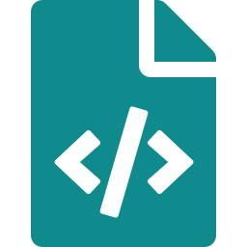


Submission and grading
DUE
12:00 noon · 27 April 2026
Email Prof. Helal and Junjie Li (lijunjie@ufl.edu)
Lab4_<YourNames>.zip
PartOne/
C/C++ services as functions + main(), for each RPi
One member submits; list all full names, and put names in file names
README — distribution of effort
Comments and documentation count toward your grade
PartTwo/
IoT-DDL file from the Builder
Be ready to demo and walk through your code with the TAs
Demo IoT Application code
All members attend online grading — absences cost points
Notes:
Remind groups to keep track of who did what as they go, since the README in PartOne must describe the distribution of effort.

Slide 19
Think in services first
BEFORE YOU START
Pick a scenario your sensors and actuators can really deliver, define each service's inputs and outputs, then decide how order and conditions will link them. Questions?
Notes:
Open the floor for questions about scenarios, hardware availability, and group formation for the extra credit.

